Slide 1
AMAZON FRESH ANALYTICS

Slide 2
TASK - 1

Slide 3
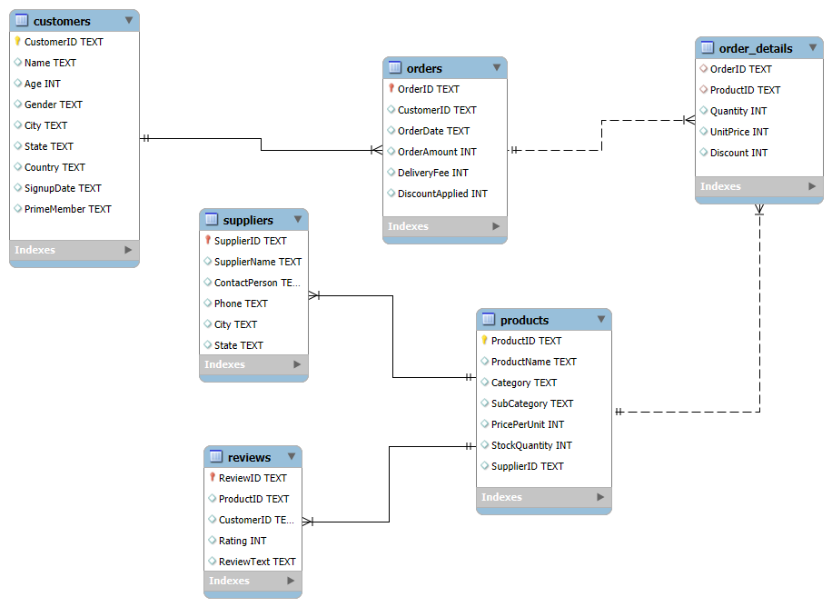
ER - DIAGRAM

Slide 4
TASK - 2

Slide 5

CUSTOMERS TABLE
Primary Key: CustomerID
Foreign Keys: None
Relationships:
One-to-many with Orders (1 customer can place many orders)
One-to-many with Reviews (1 customer can write many reviews)

Slide 6
ORDERS TABLE
Primary Key: OrderID
Foreign Keys: CustomerID
Relationships:
Many-to-one with Customers (many orders belong to 1 customer)
One-to-many with Order_Details (1 order contains many items)

Slide 7
PRODUCTS TABLE
Primary Key: ProductID
Foreign Keys: SupplierID
Relationships:
Many-to-one with Suppliers (many products supplied by 1 supplier)
One-to-many with Order_Details (1 product can appear in many orders)
One-to-many with Reviews (1 product can have many reviews)

Slide 8
SUPPLIER TABLE
Primary Key: SupplierID
Foreign Keys: None
Relationships:
One-to-many with Products (1 supplier provides many products)

Slide 9
REVIEWS TABLE
Primary Key: ReviewID
Foreign Keys: ProductID & CustomerID
Relationships:
Many-to-one with Products (many reviews about 1 product)
Many-to-one with Customers (many reviews written by 1 customer)

Slide 10
ORDER DETAILS TABLE
Primary Key: Composite of OrderID +
ProductID or OrderDetailID
Foreign Keys: OrderID & ProductID
Relationships:
Many-to-one with Orders (many items belong to 1 order)
Many-to-one with Products (many order items can reference 1 product)

Slide 11
TASK - 3

Slide 12
EXPLANIATION
Filtering the customer details from the Customers table where the City is 'Lake Brianna'.

Slide 13
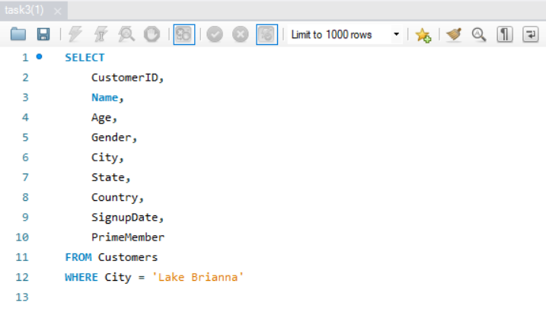

Slide 14
EXPLANIATION
Finding the product details from the Products table where the Category is 'Fruits'.

Slide 15
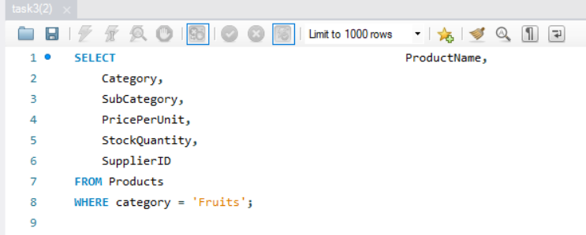

Slide 16
TASK - 4

Slide 17
EXPLANIATION
Recreating the customer table
And making the cutomer_id as a primary key.
Also age > 18 and cannot be null
And also set the default values for prime member “No”

Slide 18
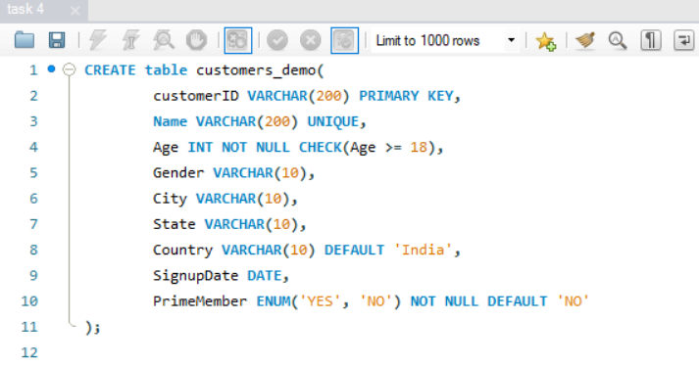

Slide 19
TASK - 5

Slide 20
EXPLANIATION
Creating a new values for the product table using insert statements.
And also mention how to delete the newely insert values using delete statements.

Slide 21
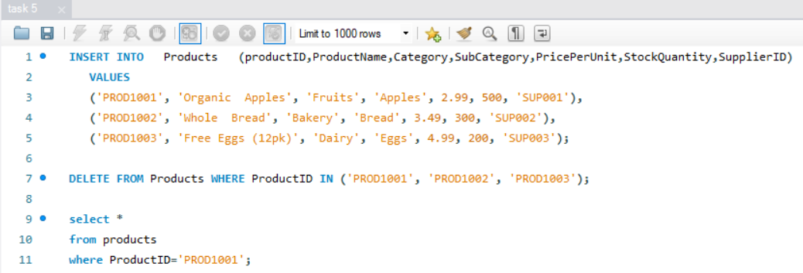

Slide 22
TASK - 6

Slide 23
EXPLANIATION
Updating the stock quantity of a product where ProductID matches a specific ID using update statement.

Slide 24
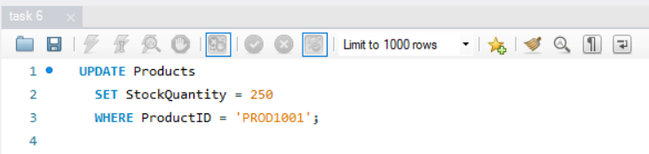

Slide 25
TASK - 7

Slide 26
EXPLANIATION
Deleting the supplier from the supplier table where their city matches the specific value.
Using delete statement.

Slide 27
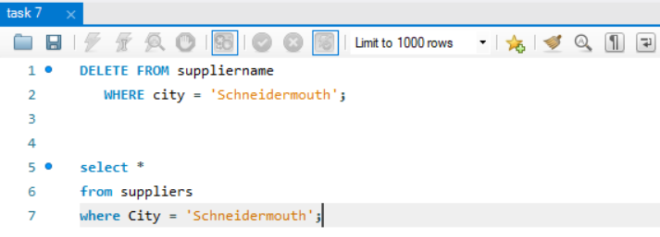

Slide 28
TASK - 8

Slide 29
EXPLANIATION
Using a check constrain to check the rating is in between 1 and 5.
To check I used inserting a new values to the rating.

Slide 30
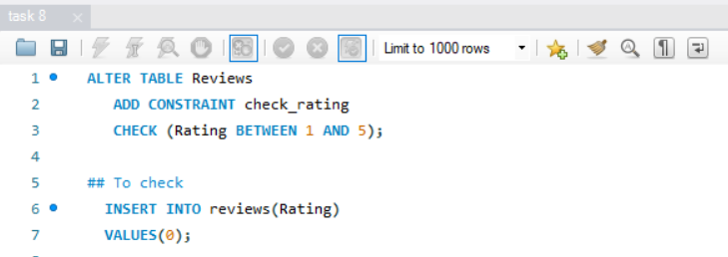

Slide 31
EXPLANIATION
Modifying the prime member column and giving the default values as ‘no’.
To achieve that I used alter table statement.

Slide 32
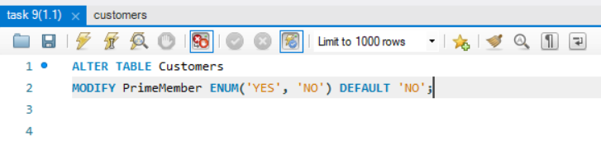

Slide 33
TASK - 9

Slide 34
EXPLANIATION
Finding the orders who have placed an order after ‘2024-01-01’ .

Slide 35
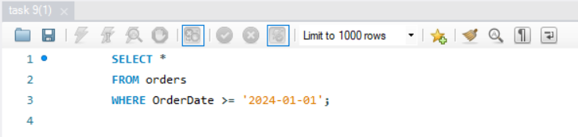

Slide 36
EXPLANIATION
Here joining the product table and review table and using the having statement to find the average rating.
It will display the average rating is greather than 4.

Slide 37
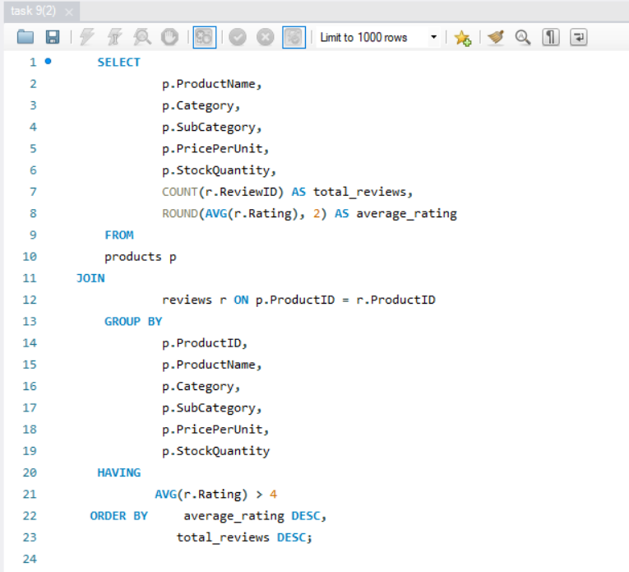

Slide 38
EXPLANIATION
Here i am finding the total unit sold and total revenue by using the group by statement and sum aggregation functions
In the second part I am finding the total sales and ranking the sales by using rank() statement.

Slide 39
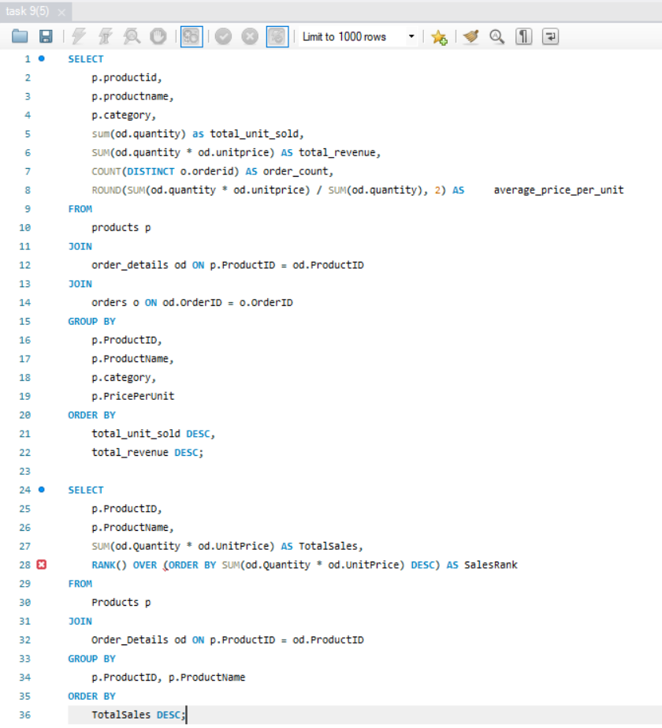

Slide 40
TASK - 10

Slide 41
EXPLANIATION
Joining the orders table and customers table.
Using a aggregation function sum and count to calculate total orders and total spend.
And using a orderby to display a totalspend in descending order.
Here I find the each customers total spending.

Slide 42
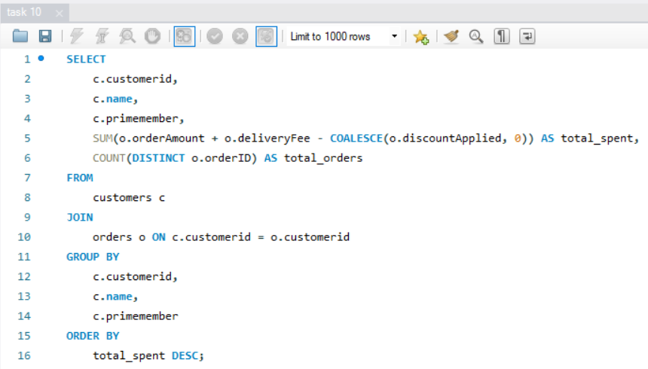

Slide 43
EXPLANIATION
Here I used a CTE to make the query more readable.
Using the rank() statement to Rank the customers who have spend more.

Slide 44
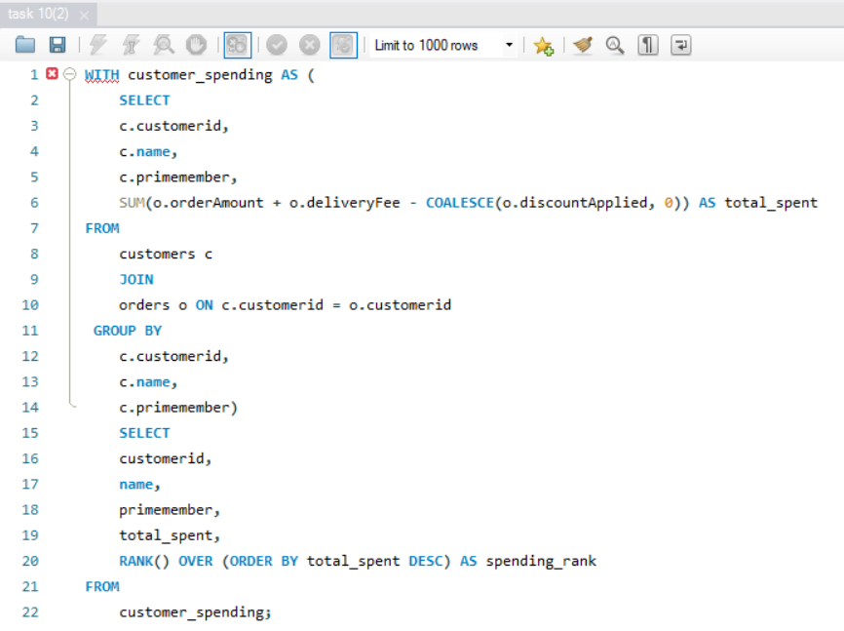

Slide 45
EXPLANIATION
Here I additionaly added a COUNT(DISTINCT) to the order_id to identify the total orders.
And also I mentioned total spend above 5000

Slide 46
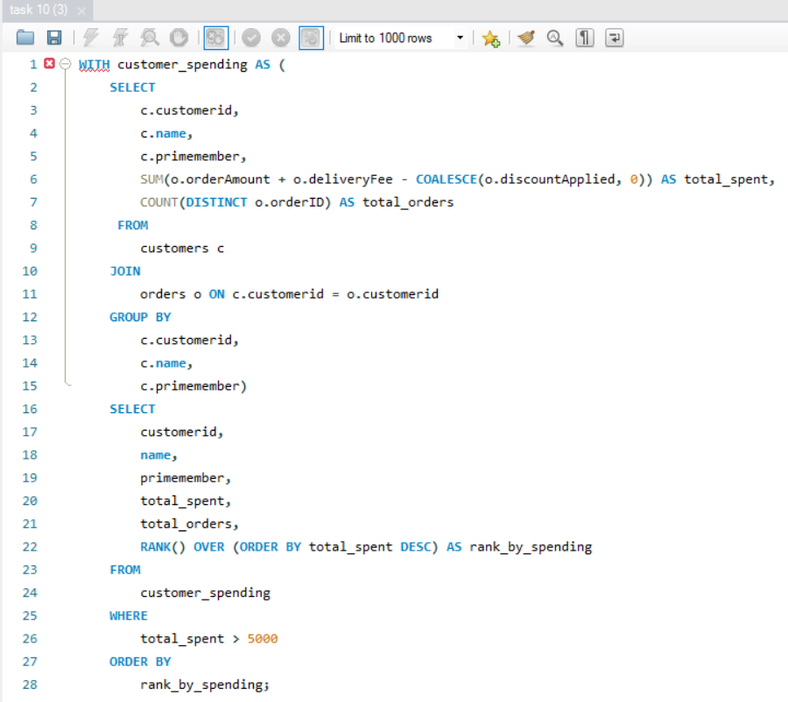

Slide 47
TASK - 11

Slide 48
EXPLANIATION
JOINED the orders and orders details table.
And I calculated the total revenue per order

Slide 49
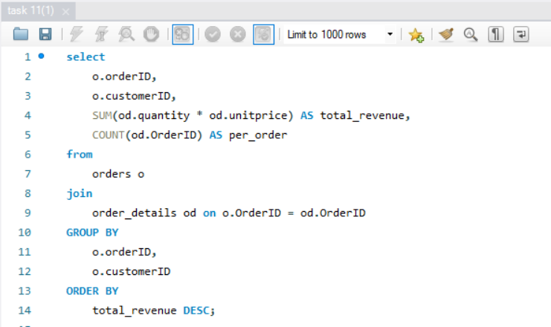

Slide 50
EXPLANIATION
JOINED the orders and orders details table.
And I used a aggregate function min ,max to find most orders placed in the specific time period.

Slide 51
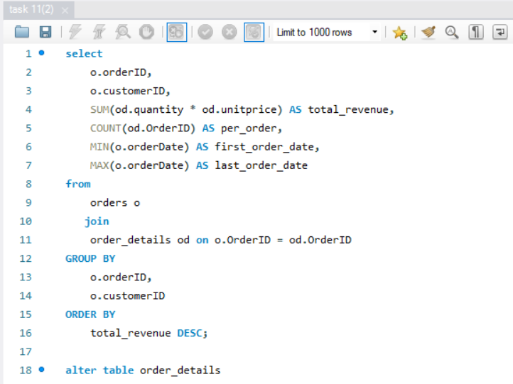

Slide 52
EXPLANIATION
Here I used a aggregate function sum is to calculate the total stock quantity.
And also I write a query to supplier details to identify the stock quantity.

Slide 53
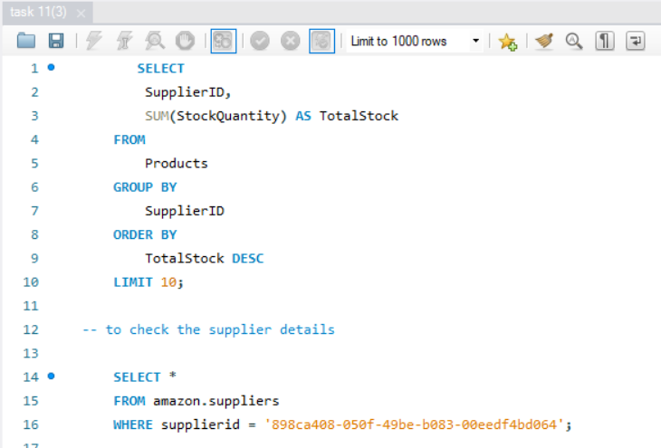

Slide 54
TASK - 12

Slide 55
EXPLANIATION
Creating a new table called categories001.
Creating a column category and subcategory.
Seperating a category and subcategory from the product table.

Slide 56
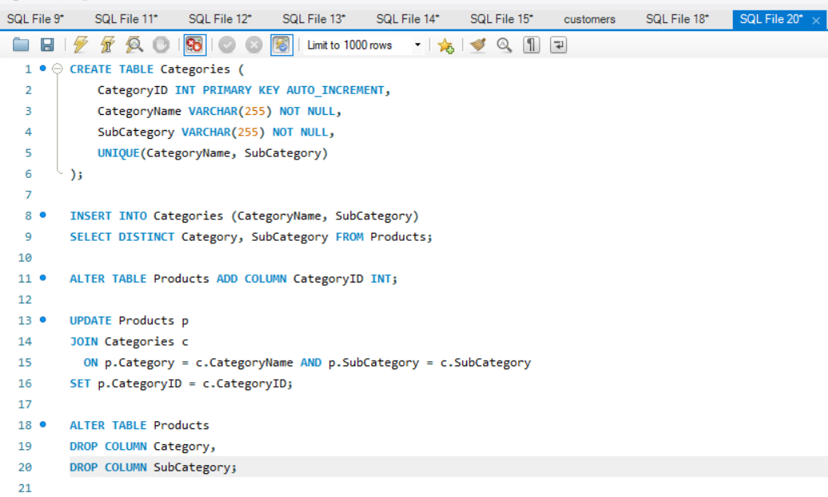

Slide 57
EXPLANIATION
Creating a new foreignkey for product table.

Slide 58
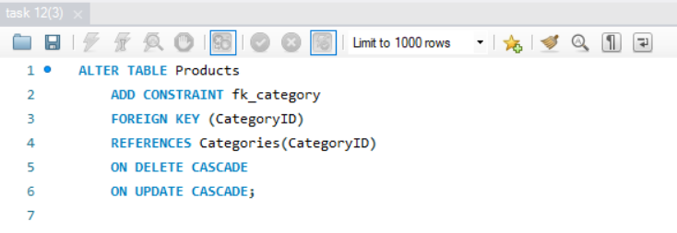

Slide 59
TASK - 13

Slide 60
EXPLANIATION
Here I used a subquery.
And joining the order details and product table.
Using a sum function to calculate the total revenue.
And used the rank() function to calculate the top 3 rank for total revenue .

Slide 61
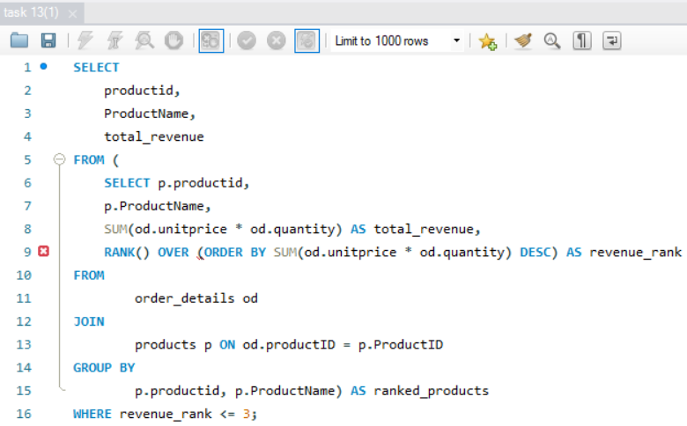

Slide 62
EXPLANIATION
Here I used a select distinct to find the customer who haven’t placed any order.

Slide 63
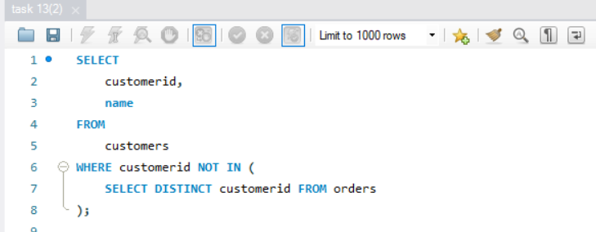

Slide 64
TASK - 14

Slide 65
EXPLANIATION
Finding the highest concentration of prime members that which city have.

Slide 66
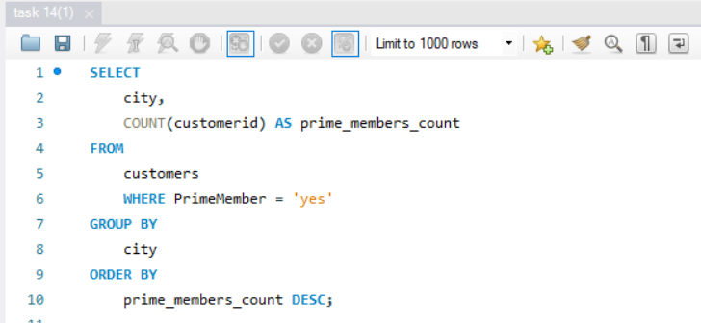

Slide 67
EXPLANIATION
JOINING the order details and category table.
And used a count function to calculate the top 3 most frequently orded category.

Slide 68
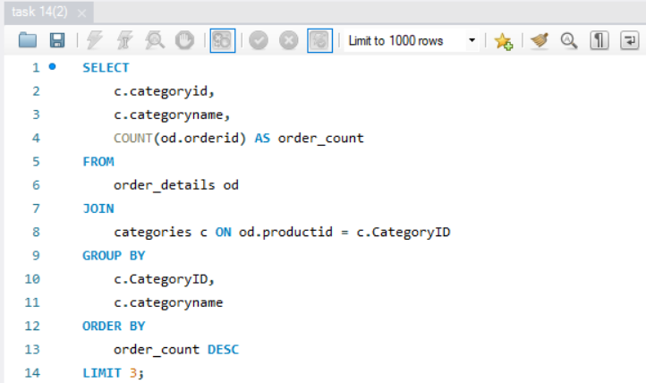

Slide 69
Thank you

